Slide 1
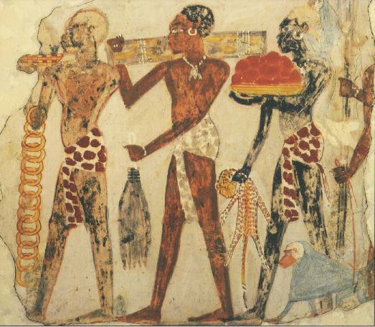
Kingdoms of Africa
Villegas Middle School
Fall 2007
Mr. Clutter

Slide 2
Mali
Ghana
Nubia
Songhay
Africa was the home of four great civilizations; Nubia, Ghana, Mali and Songhay.
Enter
Enter
Enter
Enter

Slide 3
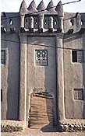
GHANA

Slide 4
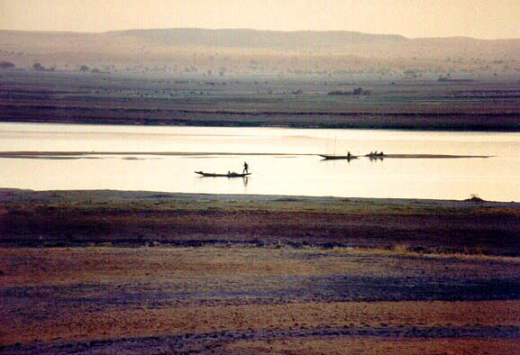
Ghana developed in West Africa between the Niger (NI-jhur) and the Gambia Rivers. It was an important kingdom there from about AD300 to about 1100. The rivers helped Ghana to grow rich because they were used to transport goods and develop trade. Ghana also collected taxes from traders who passed through the kingdom. The people called their nation Wagadu; we know it as Ghana --that was the word for war chief.

Slide 5
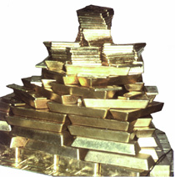
The kingdom of Ghana probably began when several clans of the Soninke people of west Africa came together under the leadership of a great king named Dinga Cisse.
Ghana had few natural resources except salt and gold. They were also very good at making things from iron. Ghanaian warriors used iron tipped spears to subdue their neighbors, who fought with weapons made of stone, bone, and wood.

Slide 6
"The King . . .(wears). . . necklaces round his neck and bracelets on his forearms and he puts on a high cap decorated with gold and wrapped in a turban of fine cotton. He (meets people) in a domed pavilion around which stand ten horses covered with gold-embroidered materials…and on his right, are the sons of the (lesser) kings of his country, wearing splendid garments and their hair plaited with gold.
At the door of the pavilion are dogs of excellent pedigree. Round their necks they wear collars of gold and silver, studded with a number of balls of the same metals."

Slide 7
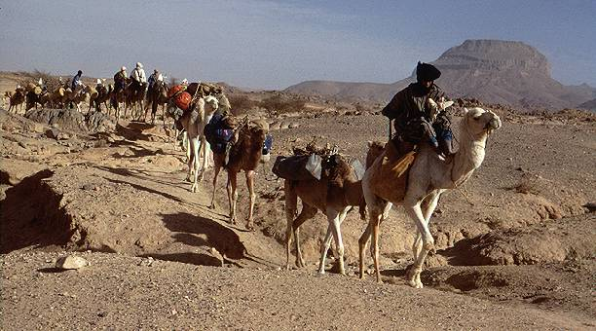
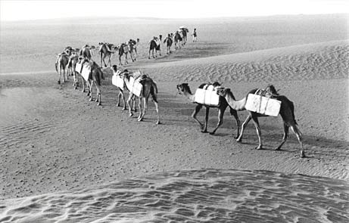
Ghana became a rich and powerful nation, especially when the camel began to be used as a source of transport. Ghana relied on trade and trade was made faster and bigger with the use of the camel.

Slide 8
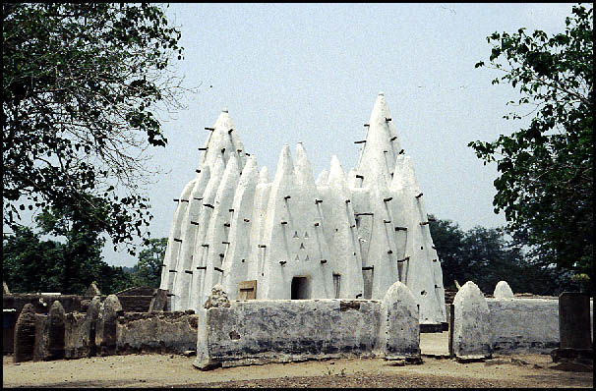
Islamic Mosque in Ghana
blankbluesky.com/ travel/ghana/
After 700 AD, the religion of Islam began to spread over northern Africa. Followers of this religion are called Muslims. Muslim warriors came into Ghana and fought with the non-Islamic people there. This weakened the great civilization of Ghana. Local warriors then decided to break away from the power of Ghana and form their own local kingdoms. This ended many of the trade networks. This eventually weakened the civilization of Ancient Ghana.
Return

Slide 9
Nubia

Slide 10
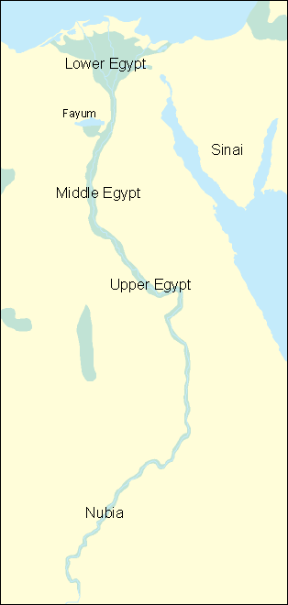
Nubia was a great civilization that developed along the Nile River south of Egypt. They shared many of the same cultural traits as Egypt such as religion, architecture and art.

Slide 11
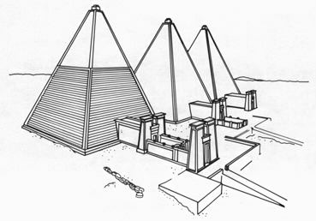
These are the pyramid of Ancient Nubia. They were used as tombs. Although they are similar to those of Ancient Egypt, they have some differences. Compare these pyramids with those of ancient Egypt.

Slide 12
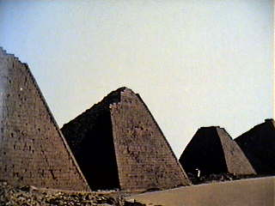
Nubian Pyramids
As you look at the following pictures, think of these questions: What are the pyramids made of? How many sides are there? How large are they? (Notice person next to middle one.)

Slide 13
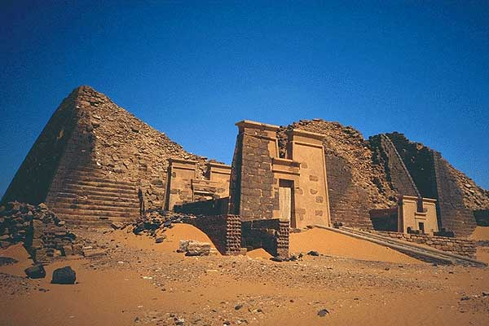
Nubian Pyramids
Are large blocks used or smaller bricks? Is there an entrance leading up to the pyramid?

Slide 14
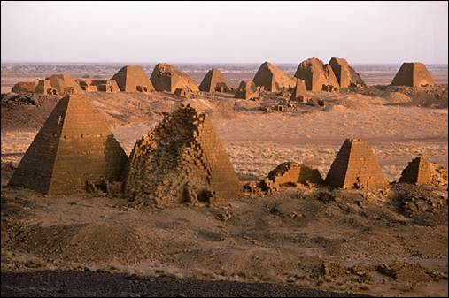
Nubian Pyramids

Slide 15
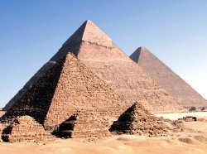
These are the pyramids of Egypt. Compare them to those of Nubia.

Slide 16
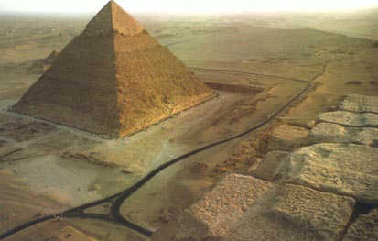
This is one of the biggest pyramids in Egypt. The pyramid of Khufu. The Egyptian pyramids were much larger than those of Nubia, but there were many more pyramids in Nubia than in Egypt.

Slide 17
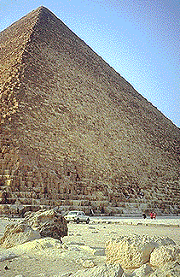
Notice the people at the base of this Egyptian pyramid. This helps to show the size of the pyramid.

Slide 18
Nubian Pyramids
Egyptian Pyramids
same
Smaller
Steeper
Large
Big blocks
Triangular
Tombs
different
different

Slide 19
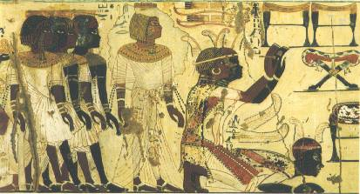
The Land of Nubia
For many centuries, the people and culture of Ancient Nubia were a mystery to the world. Even the Ancient Greeks wrote about an advanced culture that was mostly unknown to other civilizations of the time.

Slide 20

Nubian Hieroglyphs | Cursive Version | Nubian Hieroglyphs | Cursive Version
One reason little was known about the culture was that they did not write down their history until late in ancient times. Another reason is that they were isolated geographically. Outside people would need to cross harsh desert or many waterfalls, called cataracts, to reach Nubia.
I
T
K
N
W
D
Nubian writing was similar to Egyptian writing but developed into a completely separate language later in time.

Slide 21
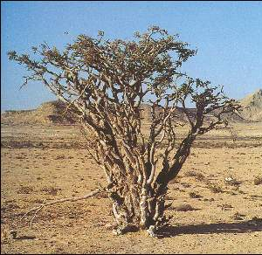
Ancient Nubia was a great kingdom that produced many resources like gold, ivory, copper, frankincense and ebony.
Nubia was also known as Kush and The Land of the Bow. Nubian archers (warriors who used a bow and arrow) were feared by all who saw them in battle.
Nubia had a long line of powerful kings. They were often at war with Egypt, to the North. From about 2,000 to 1,000 BC, Egypt controlled Nubia but when Egypt weakened, Nubia came north and conquered Egypt (800-700 BC.)
A frankincense tree. The resin was used to make good smelling incense.
Return

Slide 22
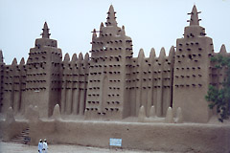
Mali

Slide 23
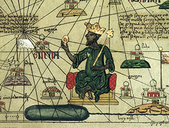
A powerful king named Sundiata ruled this area from around 1230-1255 AD. He led the people in conquering and expanding his kingdom to be as great as Ghana had been.
Perhaps the greatest king of Mali was Mansa Musa (1312-1337). He developed the gold and salt trade of Mali and his kingdom became very powerful and rich.

Slide 24
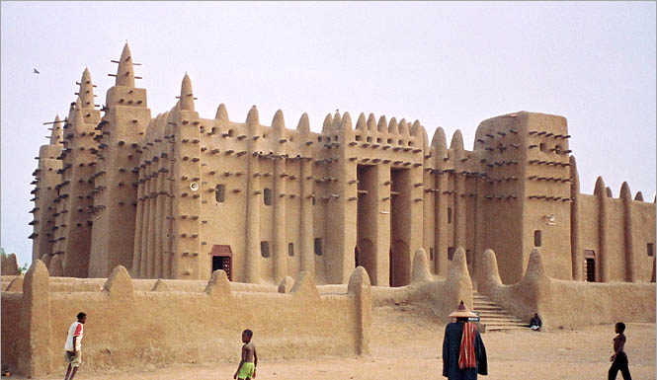
Mansa Musa was a Muslim, meaning he followed the religion of Islam. He built many beautiful mosques or Islamic temples in western Africa.

Slide 25

In 1324 Mansa Musa made a pilgrimage ( a journey to a holy place) to Mecca, which is a holy city in Arabia, with 60,000 servants and followers and 80 camels carrying more than 4,000 pounds of gold to be distributed among the poor. Of the 12,000 servants 500 carried a staff of pure gold. This showed his power and wealth to the other people he visited.

Slide 26
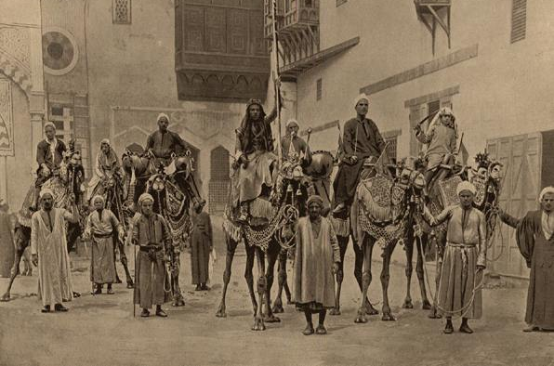
When Mansa Musa died there were no kings as powerful as he was to follow. The great kingdom of Mali weakened. Eventually a group of people known as Berbers came into the area and other people came up from the south to claim territory that was once part of the kingdom. Although Mali fell, another advanced African kingdom took its place, the kingdom of Songhay.
The Berbers still live in North Africa. This picture, taken in 1893, shows a Berber group.
Return

Slide 27
Africa produced many great civilizations. During the time of the Middle Ages of Europe, the African kingdoms of Mali, Ghana and Songhay were places of advanced learning and great wealth. At the time of ancient Egypt, Nubia was a powerful force with an advanced culture. Strong leaders and vast natural resources helped these cultures rule large areas of northern and western Africa for hundreds of years.
Return

Slide 28
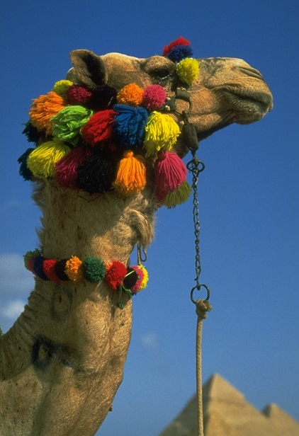
Songhay

Slide 29
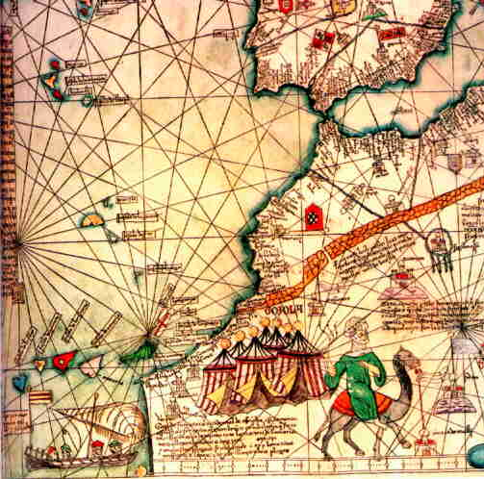
This map was created in 1375. The same trade routes were used by the merchants of the Songhay kingdom. What kinds of pictures do you see on the map and why do you think the mapmaker put them there?

Slide 30
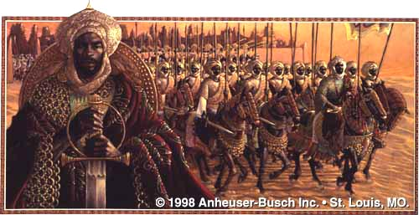
The picture above is one artist’s idea of what the great Songhay leader, Sunni Ali might have looked like. Sunni Ali saw that the kingdom of Mali was weakening and he led his soldiers to conquer the area. He began the kingdom of Songhay. He also set up a complex government to rule all the lands he had conquered.

Slide 31
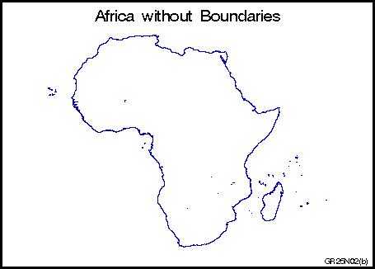
Silk, Ceramics, Beads, Islam from Europe and Asia
All three kingdoms of West Africa relied on trade for their strength and wealth.
Salt
Timbuktu
Gao
Jenne
Gold, Ivory, Wood, Slaves
Coming into West Africa
Coming from Africa and going to Europe and Asia

Slide 32
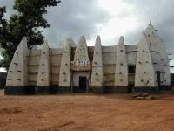
This is a photo of a mosque, or place of worship for Muslims, in western Africa. Many mosques were built of local materials.
Sunni Ali died in 1492 CE. His son took over the rule of Songhay but he did not accept Islam as a religion. Islam was accepted as a religion by many people in northern Africa. One of Sunni Ali’s generals, named Muhammad Ture, overthrew the new king and made himself king of Songhay. Ture was a follower of Islam (Muslim) and so he made Islam the religion of his kingdom.

Slide 33
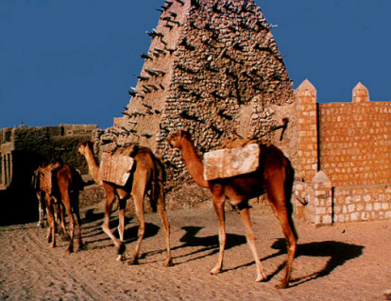
Songhay remained a rich and strong kingdom under Muhammad Ture’s rule. It had a complex government centered in the city of Gao, and great centers of learning. But later rulers were not as powerful. In the late 1500s, Morocco invaded Songhay to take its rich trade routes. Moroccans had a new weapon, the gun, and the army of Songhay did not. This led to the fall of Songhay.

Slide 34
This powerpoint was kindly donated to www.worldofteaching.com
http://www.worldofteaching.com is home to over a thousand powerpoints submitted by teachers. This is a completely free site and requires no registration. Please visit and I hope it will help in your teaching.

